Slide 1


MULTI DISCIPLINARY REAL ESTATE COMPARITIVE TOOL

Slide 2
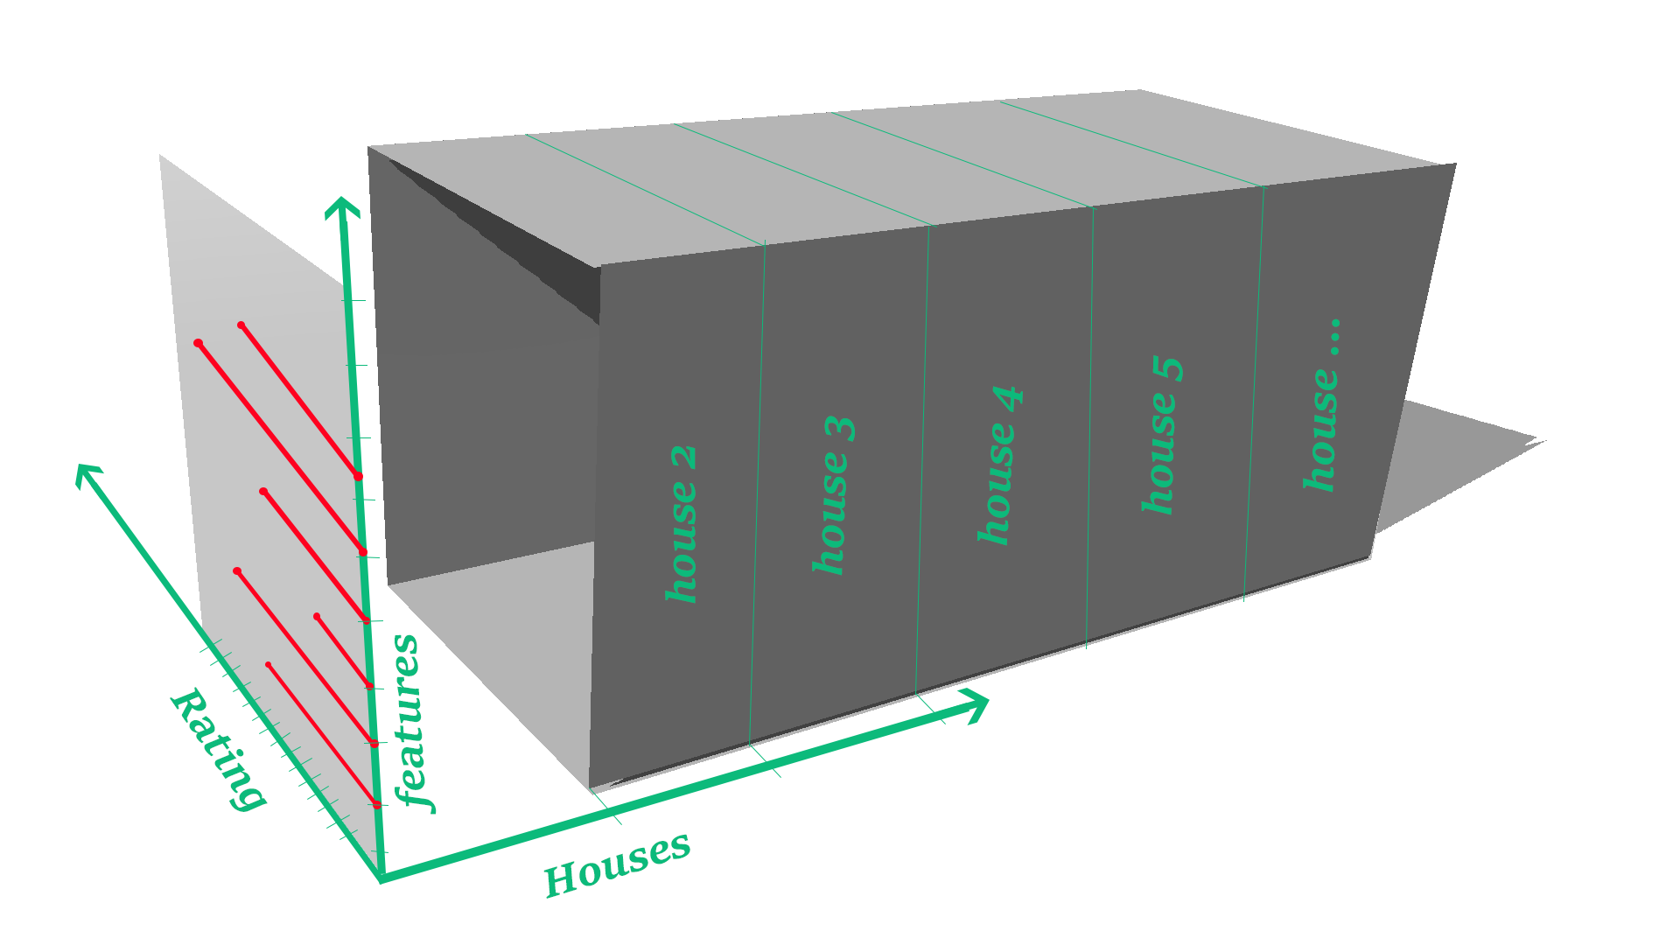
Now lets see the variables which influence the decision..

Slide 3
VARIABLES INFLUENCING DECISION
PRICE
SIZE
YEAR
BUILT
EDUCATION
AMENITIES
TRANSPORT
HEALTH & SAFETY
We normalised the values on the scale
of 0 to 10

Slide 4


Slide 5
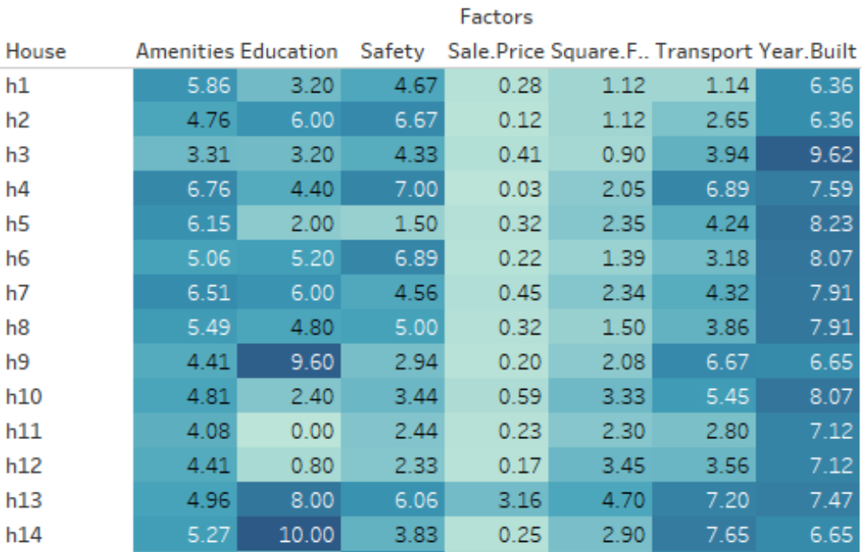
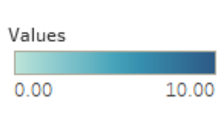

Slide 6
NORMALIZATION
VISUALIZATION
DATA COLLECTION & CLEANING
SEARCHING

